Slide 1
Analyzing single-cell data
Noah Apthorpe, Josh Fass, Maithra Raghu

Slide 2
Outline
Biological motivations
Prior work
Current work
Experiments with SPADE
Approximate TPE
PLS based analysis

Slide 3
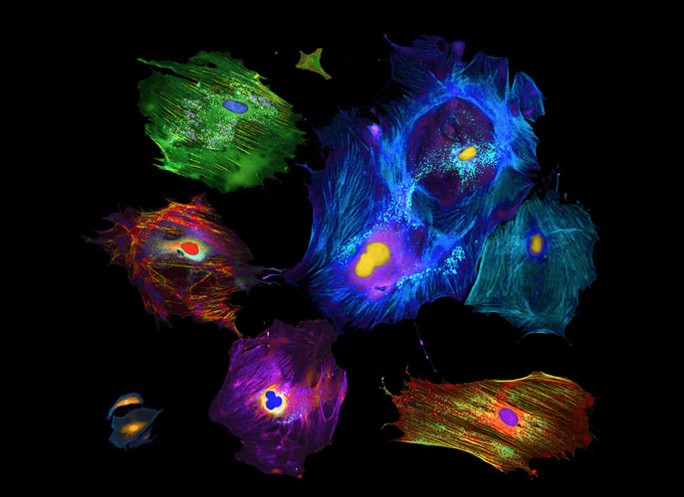
Every cell in the human body is different...
Notes:
http://research.duke.edu/1100-words/8323

Slide 4
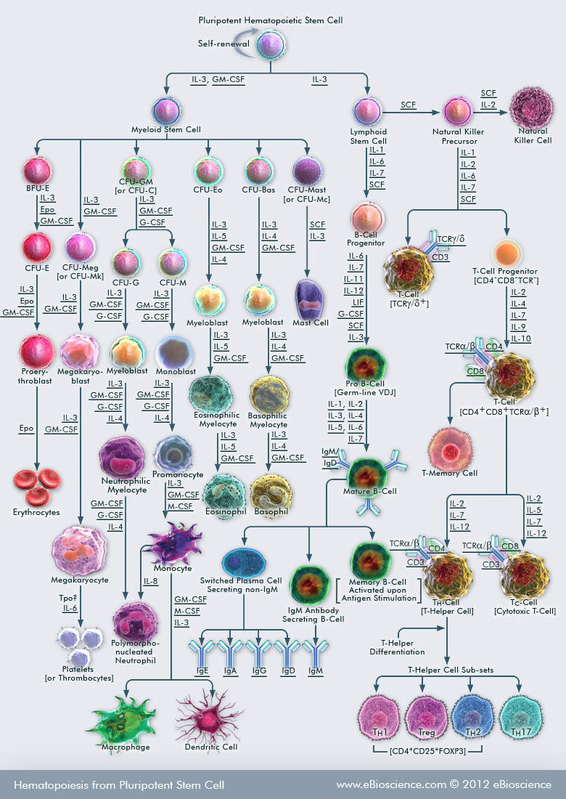
… due to repeated “specialization”
Notes:
http://www.ebioscience.com/media/images/pathways/hematopoiesis-from-pluripotent-stem-cell.jpg

Slide 5
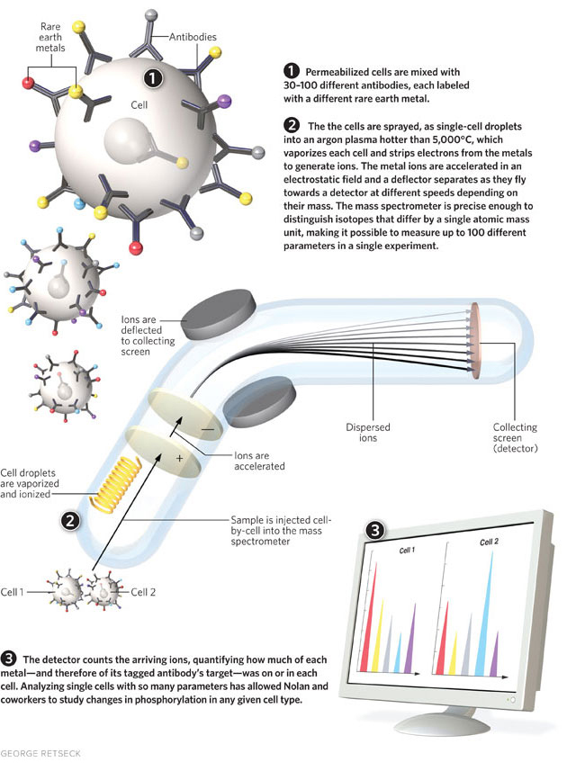
We can now make high-dimensional single-cell measurements...
Notes:
http://photos.the-scientist.com/legacyArticleImages/2011/12/11_11_Flow_Cyto1.jpg
http://www.kurzweilai.net/images/mass_cytometer_flow.png

Slide 6
… resulting in large single-cell datasets
d
n ~ 1,000,000
d ~ 50
?
?
?
?
?
?
n

Slide 7
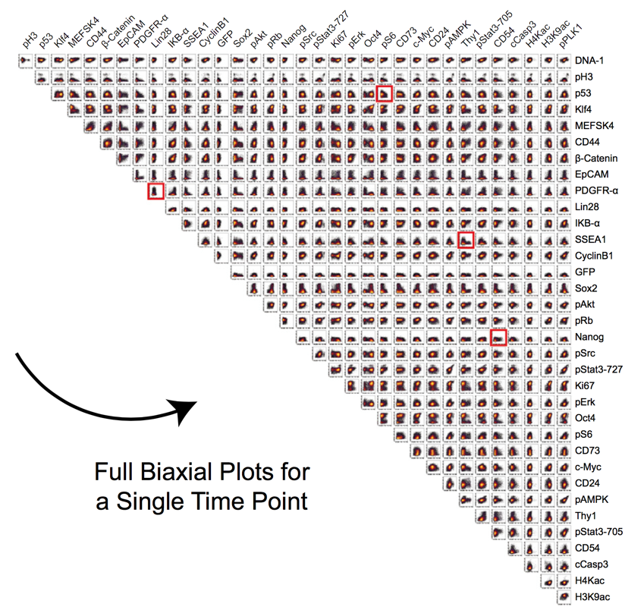
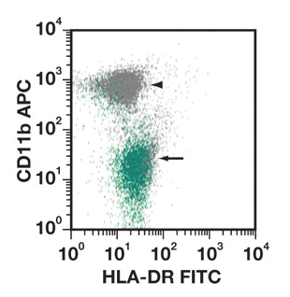
Traditionally analyzed by manual bivariate “gating”
n ~ 1,000,000
d ~ 50
Make scatterplots of 2 columns at a time
n(n-1)/2
Notes:
http://ajcp.ascpjournals.org/content/135/1/76.figures-only

Slide 8
Machine learning objectives
High-resolution data available
Big goals:
Visualize in 2D (dimensionality reduction)
Identify and characterize subtypes (clustering)
Understand cell signaling (conditional density estimation)
Understand structure of cellular variability (representation learning)
Understand iPSC reprogramming (regression?)

Slide 9
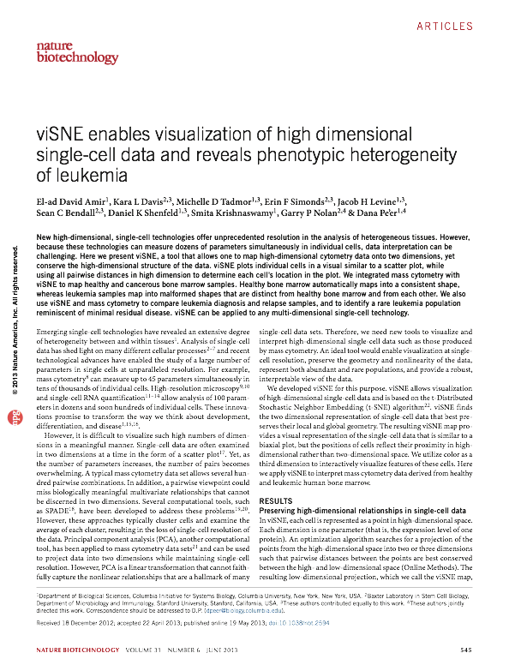
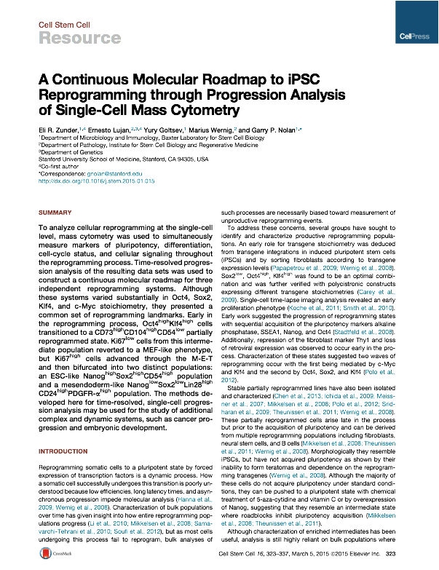
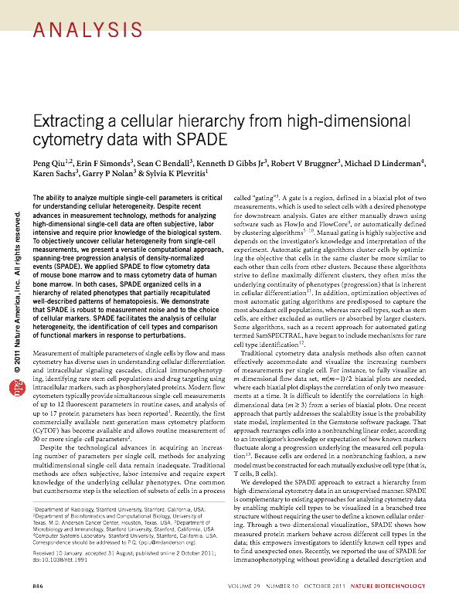
Recent high-profile work: domain-specific ML algorithms
Dimensionality reduction
Structured output prediction

Slide 10
Limitations
Complicated pipelines with many user-defined parameters, incompletely specified preprocessing
Limited probabilistic motivation
Do they distort or exaggerate structure in data?

Slide 11
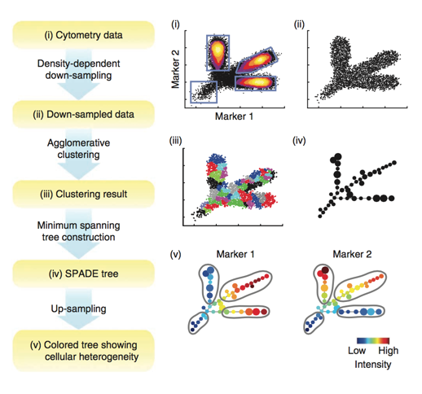
Example: SPADE

Slide 12
SPADE Overview
Design goals
2D visualization
Illustrate clusters
Recover likely tree of cellular differentiation events
Limitations
Always returns a tree
Returns inconsistent trees when run repeatedly

Slide 13
Our work
Analysis:
SPADE consistency analysis

Slide 14
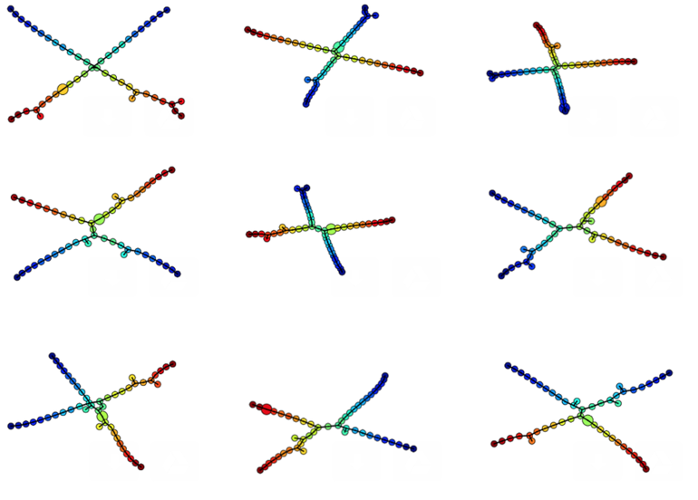
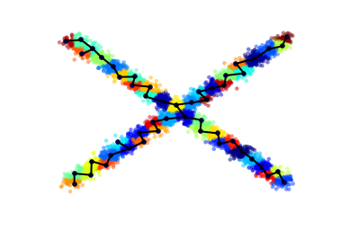
SPADE - Consistency experiments
Synthetic data: long “branches”
Outputs of repeated trials

Slide 15
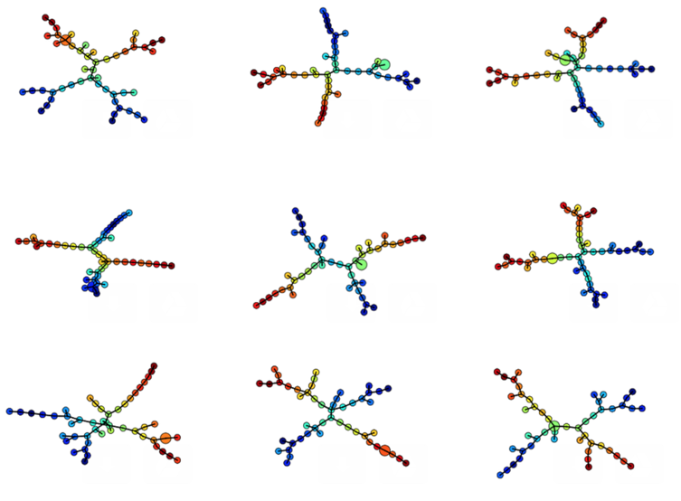
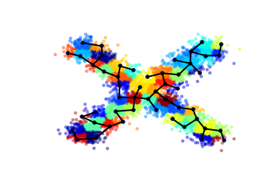
SPADE - Consistency experiments
Synthetic data: shorter “branches”
Outputs of repeated trials

Slide 16
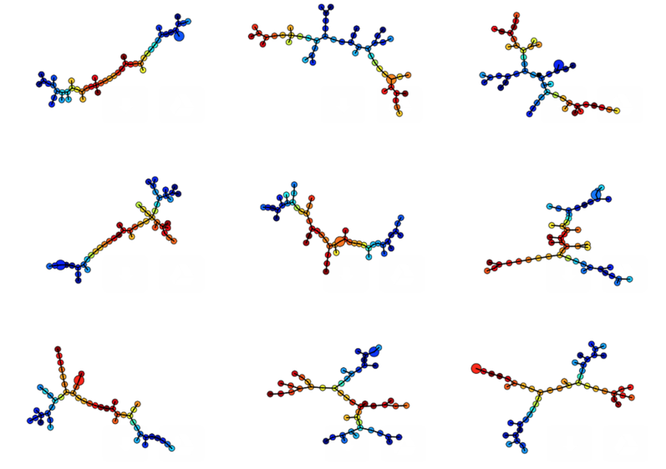
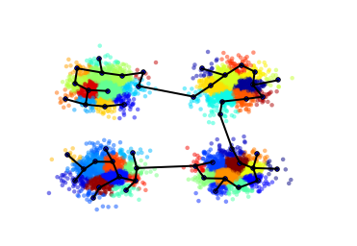
SPADE - Consistency experiments
Synthetic data: mixture of Gaussians
Outputs of repeated trials

Slide 17
Our work
SPADE consistency analysis
Density estimator

Slide 18
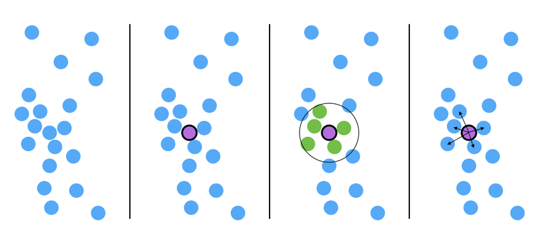
SPADE - Density-estimator inaccurate when d>2
1. Input Point cloud
2. Pick point to inspect
3. Count neighbors within radius r

Slide 19
SPADE - More accurate density-estimators possible
4. Measure average distance to k nearest neighbors
1. Input Point cloud
2. Pick point to inspect
3. Count neighbors within radius r

Slide 20
Density-estimation results
[to-do?]

Slide 21
SPADE - Conclusions
Complex domain-specific algorithms have many possible failure points, and may not be rigorously tested
Open need for this particular kind of structure-learning

Slide 22
Our work
Experiment with domain-specific methods
Apply simpler/more consistent methods instead: PCA, PLS, etc.
Develop visualization algorithms that better preserve structure

Slide 23
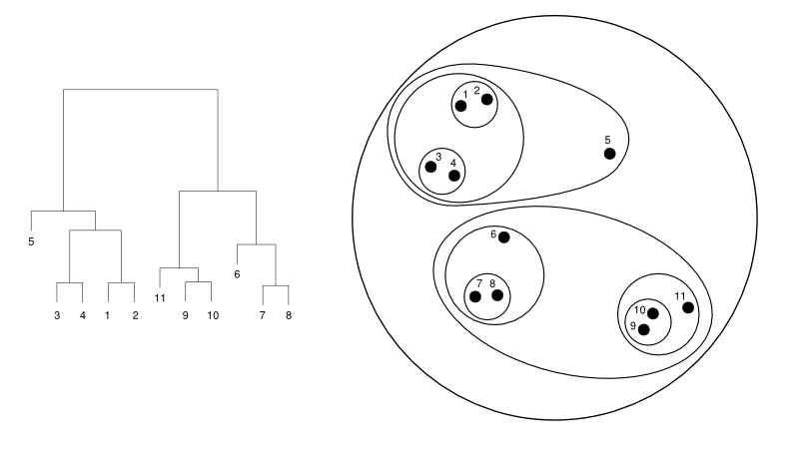
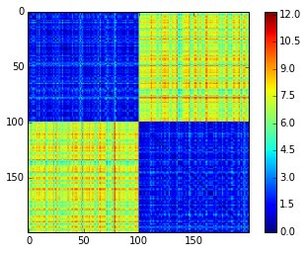
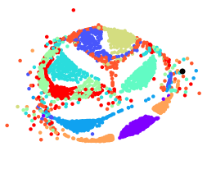
Approximate “tree-preserving embedding”
Goal: 2D visualization that preserves cluster structure
Tactic: approximately preserve hierarchical cluster tree:
Compute hierarchical clustering
Extract cophenetic distance matrix
Apply Multidimensional Scaling to distance matrix
Hierarchical agglomerative clustering
Cophenetic distance matrix
2D embedding
Notes:
ref: http://cs.jhu.edu/~razvanm/fs-expedition/hclust-example.png

Slide 24
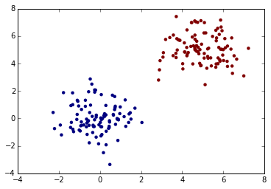
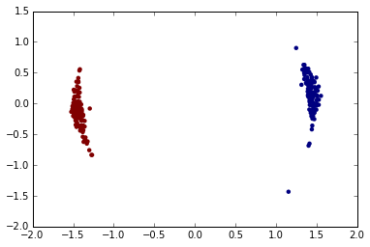
Approximate TPE: toy problem
Synthetic data: 2D mixture of Gaussians
Approximate TPE solution

Slide 25
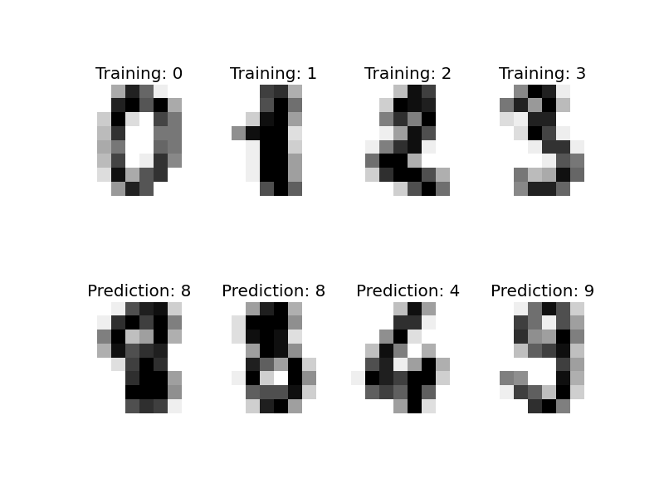
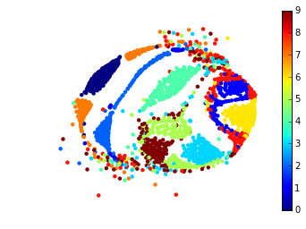
Approximate TPE: benchmark data
Example dataset: handwritten digits (from sklearn.datasets, n=1797, d=64)
Approximate TPE solution

Slide 26
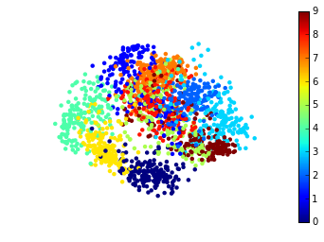
Comparing embedding quality
PCA

Slide 27
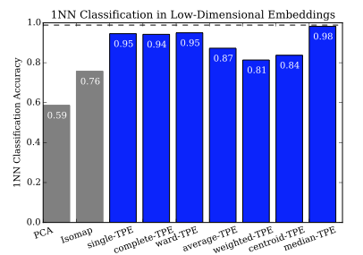
Measuring embedding fidelity: 1NN classification accuracy

Slide 28
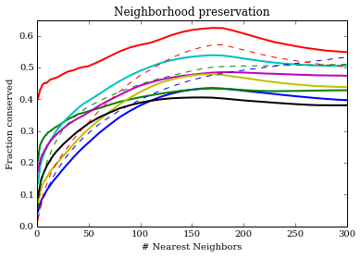
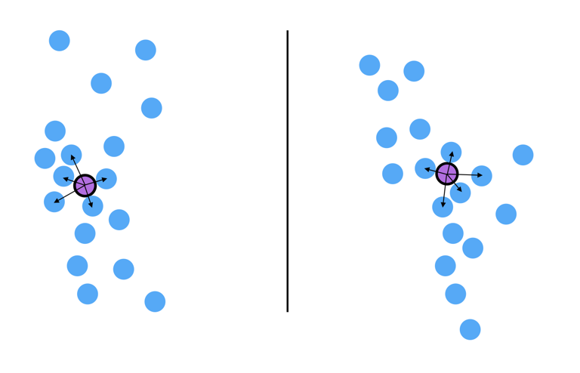
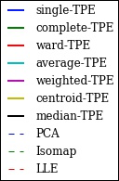
Measuring embedding fidelity: neighborhood preservation
Results:
Neighborhood preservation: How many of each point’s k-nearest neighbors are the same before and after a transformation?
Original data
Transformed data

Slide 29
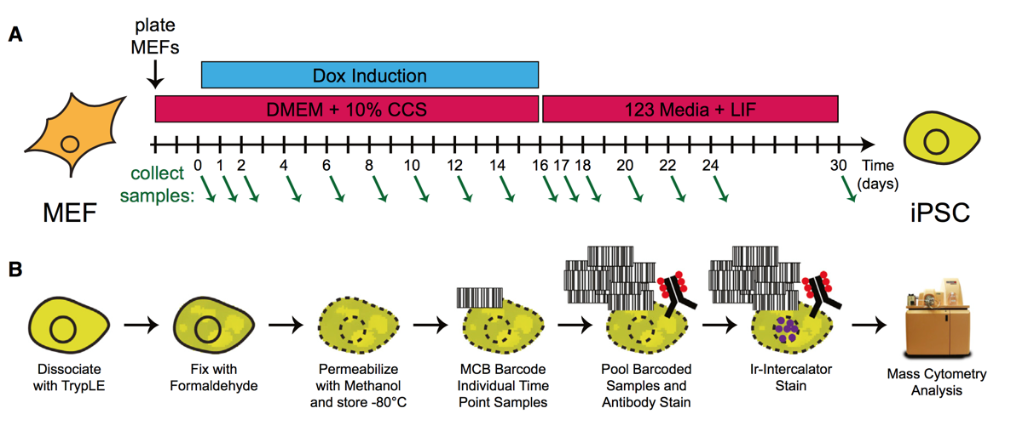
New dataset: population snapshots

Slide 30
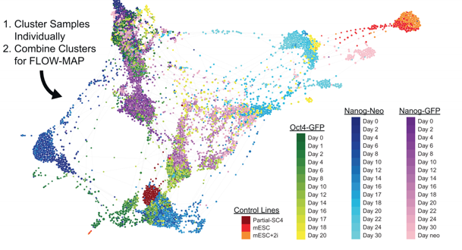
“FLOW-MAP”
Visualization algorithm based on force-directed graph layout
Very different conclusions than linear methods

Slide 31
Our work
Analysis:
SPADE consistency analysis
Density estimation
Approximate “tree-preserving embedding”
Simpler methods

Slide 32
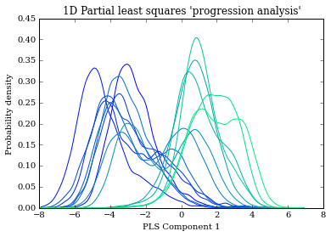
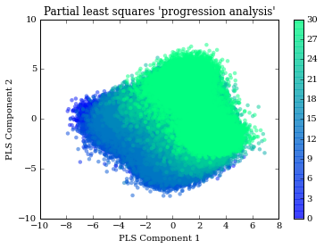
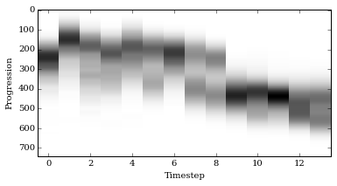
Partial Least Squares “progression analysis”
Tactic: apply PLS, predict time-stamp from features

Slide 33
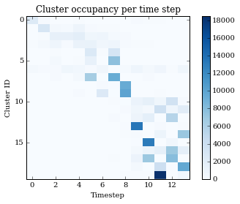
Cluster-discretized “progression analysis”
Tactic: compute a clustering of the full dataset, observe how cluster occupancy changes

Slide 34
Applying TPE to cytometry data

Slide 35
Conclusions
Lots of cool datasets from biology
plenty of room for (and interest in) better analysis methods
Difficult to objectively measure embedding quality
Important because it influences how biologists interpret their experiments

Slide 36
References

